Slide 1

Surprise Housing Price Prediction Project
A case study from "Surprise Housing," a housing company situated in the United States. The company is looking at potential properties in order to acquire houses for less than their true value and resell them for more, allowing it to enter the real estate market.
PRESENTATION
Benjamin Emmanuel
Data Science Intern
Flip Robo Technologies

Slide 2
ACKNOWLEDGMENT
I'd like to express my heartfelt gratitude to Mohd. Kashif, my SME (Subject Matter Expert), as well as Flip Robo Technologies, for allowing me to work on this project on Surprise Housing Price Prediction and for assisting me in conducting extensive research that allowed me to learn about many new things.
In addition, I used a few outside resources to help me finish the project. I made sure to learn from the samples and adjust things to fit my project's needs.

Slide 3

A PROJECT ON PREDICTING HOUSING SALE PRICE

Slide 4
INTRODUCTION
Surprise Housing is a real estate and housing company established in the United States that is attempting to break into the Australian market. The business is seeking for potential properties to purchase in order to enter the market. We must use Machine Learning to create a model that will estimate the actual worth of potential properties and help us decide whether or not to invest in them.
Surprise Housing is interested in learning which variables are crucial in predicting the sale price of a home.
What is the relationship between these feature variables and the house price?

Slide 5
AGENDA
Analytical Problem Framing
Exploratory Data Analysis (EDA)
Visualizations
Data Pre-Processing on train and test datasets
Model/s Development and Evaluation
Performing hyper parameter tuning, saving the best model and predicting the label
Conclusion and future work discussion

Slide 6
Hardware - Software Requirements and Tools Used
Hardware Used:
RAM: 16 GB
Intel(R) Core(TM) i7-9750H CPU @ 2.60GHz 2.59

Slide 7
Hardware - Software Requirements and Tools Used
Software Used:
Programming language: Python
Distribution: Anaconda Navigator
Browser based language shell: Jupyter Notebook
Libraries/Packages Used:
Pandas, NumPy, matplotlib, seaborn, scikit-learn and
pandas_profiling

Slide 8
PROBLEM STATEMENT
Houses are a basic need for everyone on the planet, so the housing and real estate sector is one of the most important contributors to the global economy. It's a huge market with a lot of different companies operating in it.
Data science is a significant tool for firms to employ to solve challenges in the domain, such as increasing overall revenue, profits, enhancing marketing methods, and focusing on shifting trends in home sales and purchases.
Machine learning approaches like as predictive modelling, market mix modelling, and recommendation systems are employed by housing firms to achieve their business objectives. One such housing company is the source of our difficulty.

Slide 9
ANALYTICAL PROBLEM FRAMING
Due to the fact that we are given two sets of data, one for training and the other for testing We'll use the train dataset to develop a machine learning model, and then use that model to make predictions for the test dataset.
Both datasets are in csv format, with 1168 rows and 81 columns for the train dataset and 292 rows and 80 columns for the test dataset. We don't know the target label in the test dataset, so we'll have to guess.
And, because this is a continuous data problem, I'll be utilizing various regression machine learning models to estimate house selling prices.

Slide 10
DATA ANALYSIS - MODEL BUILDING FLOWCHART
Import Dependencies or Libraries
Data set Collection
Data preprocessing
Encoding
EDA and Visualization
Checked for Null Values
Checked for correlation
Checked for Outliers/Skewness
Proceed for Model building
Saving the Final_Model
Hyper Parameter Tuning
R2 Score, Cross Validation Score, MSE, RMSE, MAE

Slide 11
DATA PRE PROCESSING
Importing the necessary dependencies and libraries.
Reading the CSV file and converted into data frame.
Checking the data dimensions for the original dataset.
Looking for null values and accordingly fill the missing data.
Checking the summary of the dataset.
Checking unique values.
Checking all the categorical columns in the dataset.
Visualizing each features using matplotlib and seaborn.

Slide 12
DATA PRE PROCESSING
Performing encoding using the ordinal encoder on categorical features.
Checking for co-relation/multi-collinearity in a heatmap.
Checking for Outliers/Skewness using boxen plot and distribution plot.
Perform Scaling using Standard Scaler method.
Checking for the final dimension of dataset to confirm the input details.
Creating train test split and the best random state found in the range 1-1000.

Slide 13
EXPLORATORY DATA ANALYSIS (EDA) AND VISUALIZATION
01. Univariate Analysis
02. Multivariate Analysis
03. Correlation of Dataset
Univariate analysis is the simplest form of analyzing data. “Uni” means “one”, so in other words your data has only one variable.
Multivariate analysis is a set of statistical techniques used for analysis of data that contain more than one variable.
Correlation is used to test relationships between quantitative variables or categorical variables.
04. Correlation with Target variable
05. Conclusion
Correlation with the target variable to know how the data is related.
Summary with the conclusion of all the analysis

Slide 14
PIE PLOT
A Pie Chart is a circular statistical plot that can display only one series of data.
The area of the chart is the total percentage of the given data.
The area of slices of the pie represents the percentage of the parts of the data.

Slide 15
COUNT PLOT
Count plot method is used to show the counts of observations in each categorical bin using bars.
Parameters : This method is accepting the following parameters that are described below: x, y
This parameter take names of variables in data or vector data, optional inputs for plotting long-form data.

Slide 16
SCATTER PLOT
Scatter plots are used to observe relationship between variables and uses dots to represent the relationship between them.
The scatter method in the matplotlib library is used to draw a scatter plot.
Scatter plots are widely used to represent relation among variables and how change in one affects the other.

Slide 17
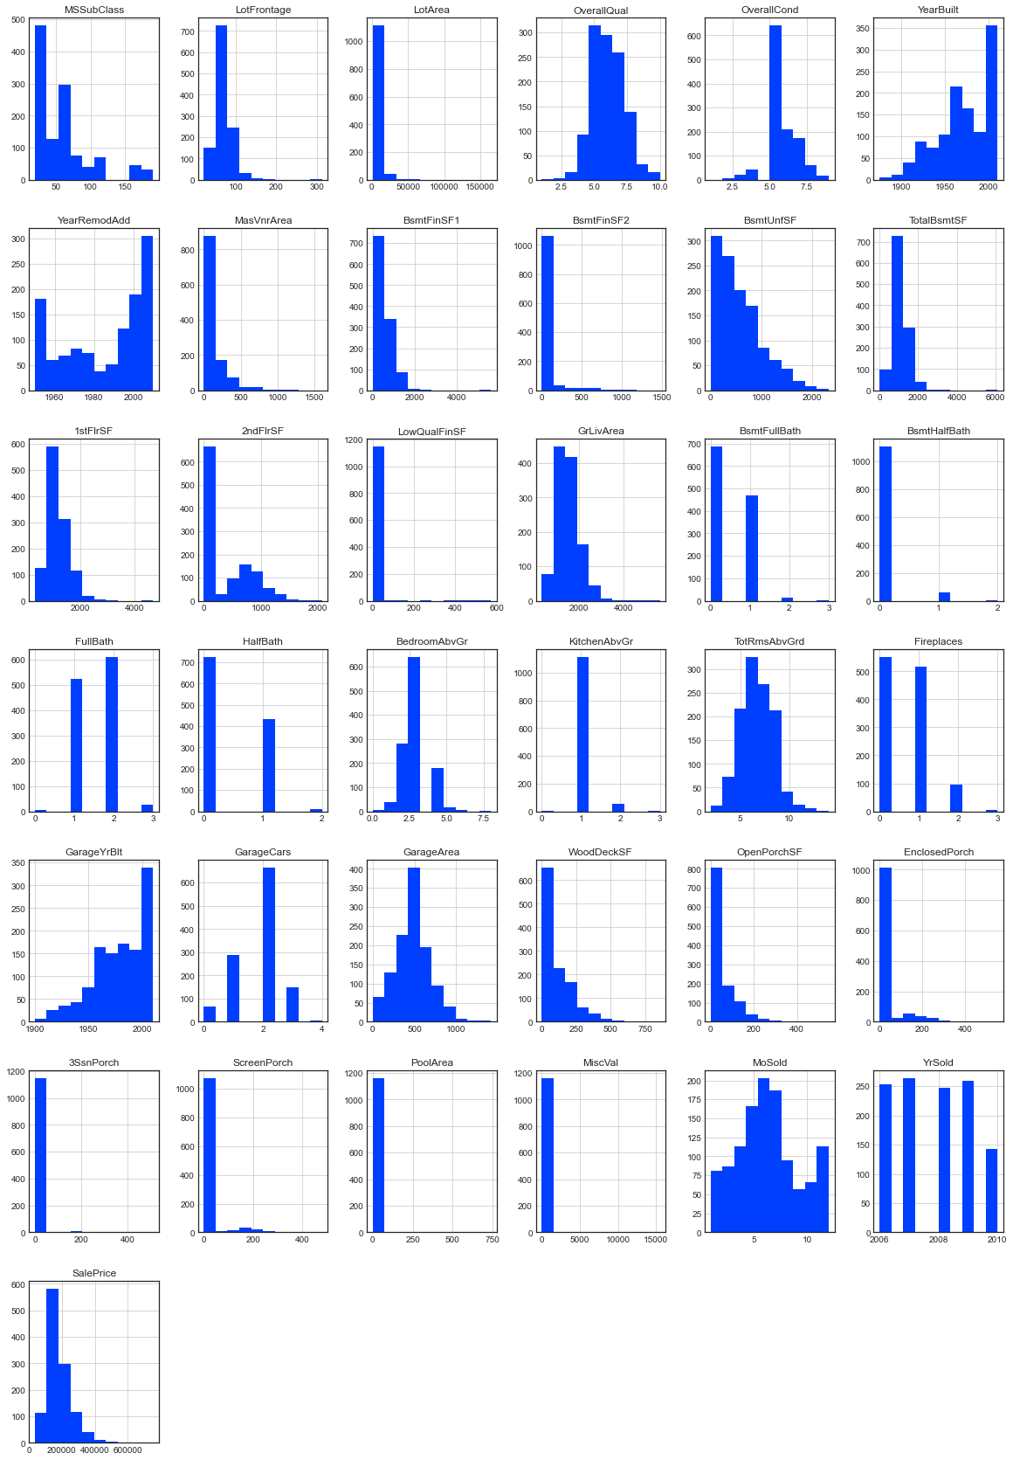
HISTOGRAM
A histogram is basically used to represent data provided in the form of some groups.
It is accurate method for the graphical representation of numerical data distribution.
It is a type of bar plot where X-axis represents the bin ranges while Y-axis gives information about frequency.

Slide 18
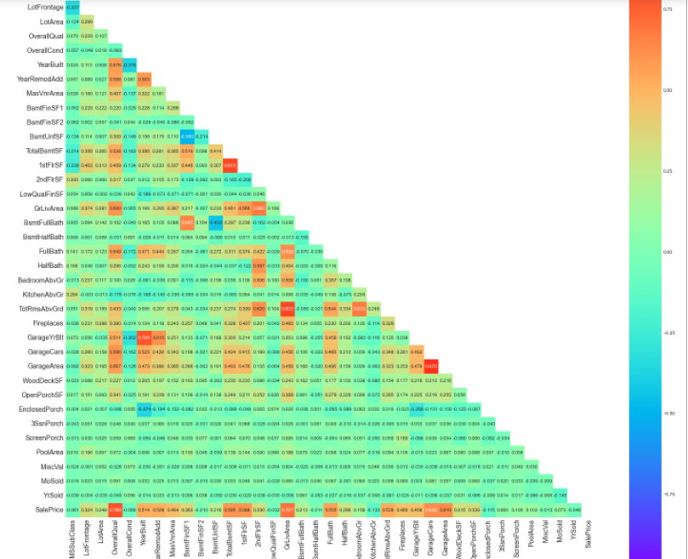
HEATMAP
A heatmap contains values representing various shades of the same color for each value to be plotted.
Usually the darker shades of the chart represent higher values than the lighter shade.
For a very different value a completely different color can also be used.

Slide 19
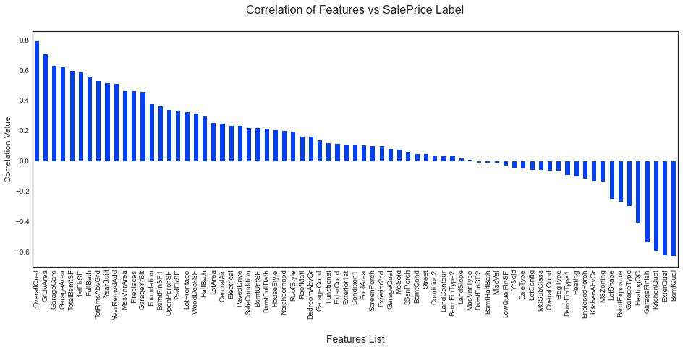
BAR GRAPH
Bar graphs are used to compare things between different groups or to track changes over time.
Here we are comparing the correlation values between the feature columns and the target label column which is Sale Price in our scenario.
It gives us an insight on positive and negative correlated column details.

Slide 20
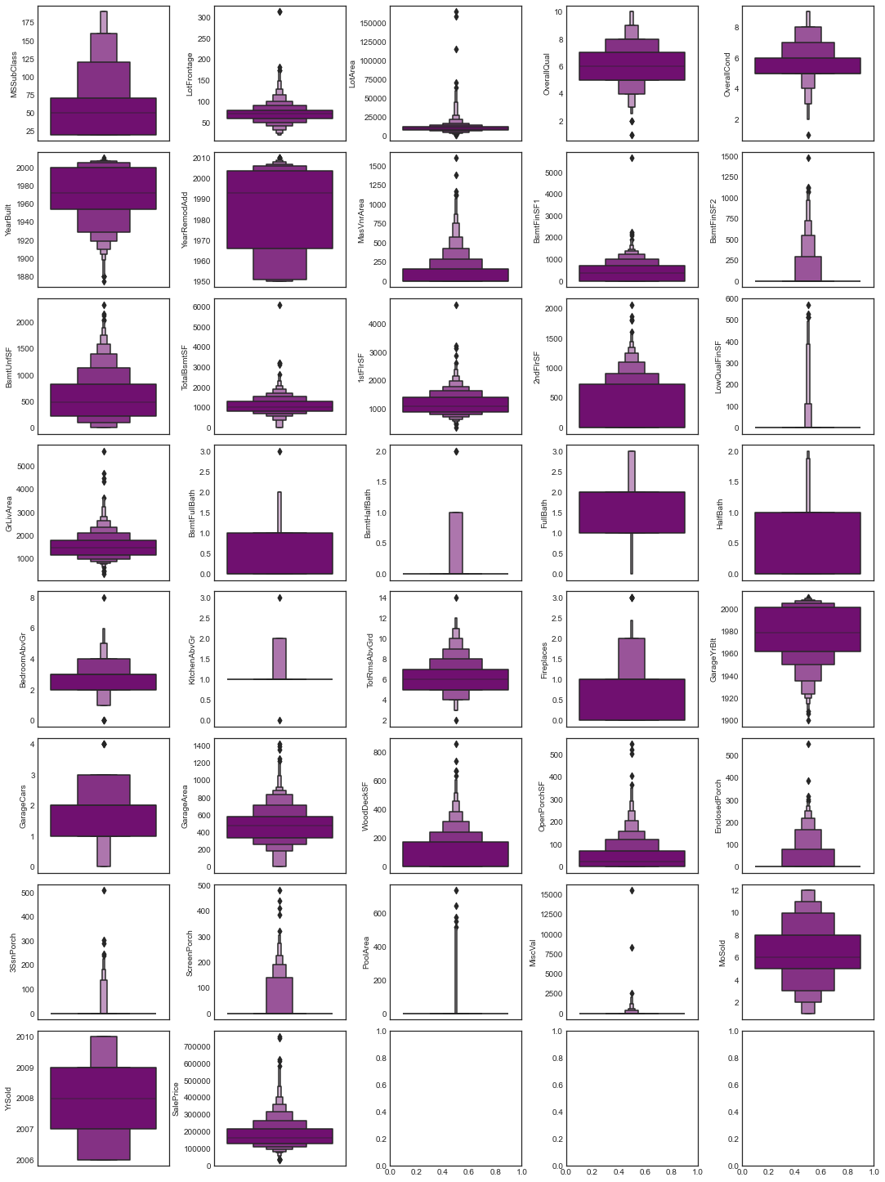
BOX PLOT
A Boxen Plot is also known as Whisker plot is created to display the summary of the set of data values having properties like minimum, first quartile, median, third quartile and maximum.
We have used it to identify the outlier details for all the numeric datatype column values.

Slide 21
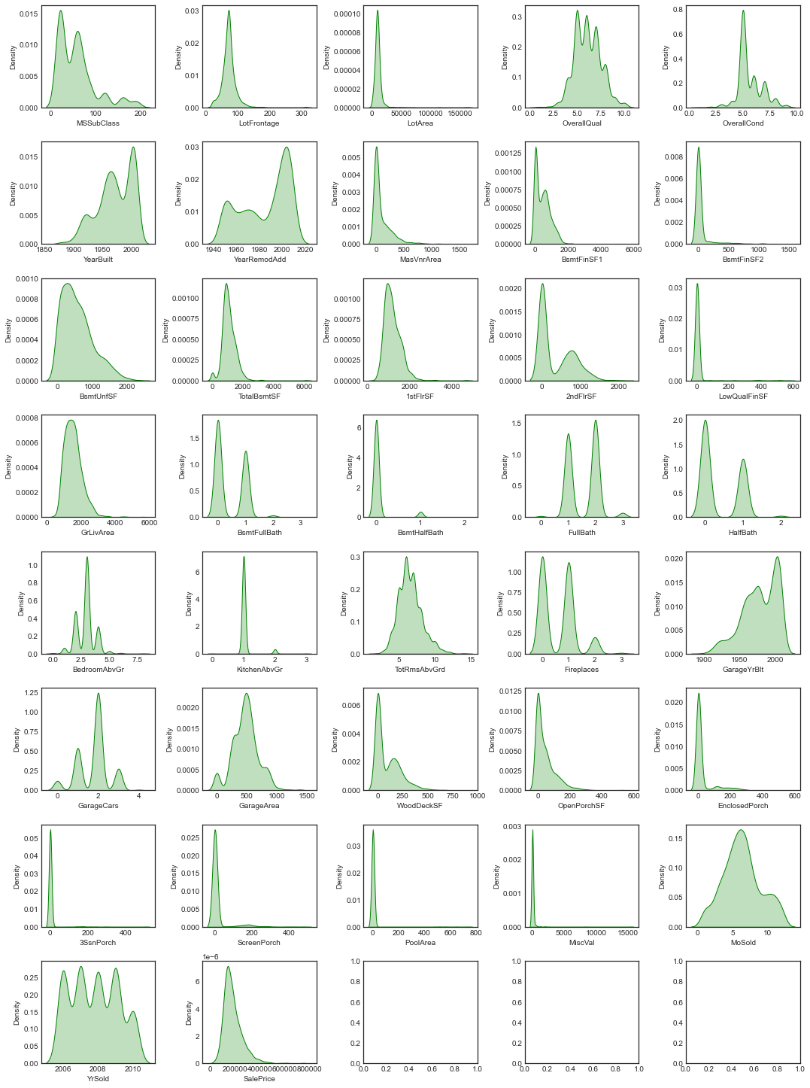
DISTRIBUTION PLOT
Distribution plots visually assess the distribution of sample data by comparing the empirical distribution of the data with the theoretical values expected from a specified distribution.
Here we have used it to analyze the skewness information for numeric datatype column values.
The acceptable form usually is a normal distribution resembling a bell shape curve.

Slide 22
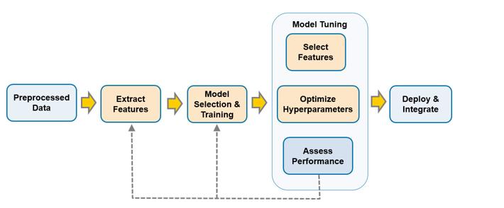
MODEL TRAINING PHASES

Slide 23
MODEL/S DEVELOPMENT
The algorithms used on training and test data are as follows:
Linear Regression Model
Ridge Regularization Regression Model
Lasso Regularization Regression Model
Support Vector Regression Model
Decision Tree Regression Model
Random Forest Regression Model
K Nearest Neighbors Regression Model
Gradient Boosting Regression Model
Ada Boost Regression Model
Extra Trees Regression Model

Slide 24
EVALUATION AND HYPER PARAMETER TUNING
The key metrics used here were:
R2 score
Cross Validation Score
MAE
MSE
RMSE
We tried to find out the best parameters list to increase our accuracy scores by using Hyperparameter Tuning.
In order to achieve a higher score we used the Grid Search CV method with 5 folds.

Slide 25
CONCLUSION AND SCOPE FOR FUTURE WORK
Throughout this research, I ran into a difficulty with a lack of data to train machine learning models on.
Many columns have the identical entries in more than 80% of the rows, reducing the performance of our model.
Another difficulty is that this data collection has a high number of missing values, which must be manually filled in the correct manner.
With some feature engineering and rigorous hyperparameter adjustment, we can still enhance the accuracy of our model.

Slide 26


